Slide 1
\LaTeX
For Scientific Documentation
By Ammar Taha Mohamedy
Building Tables Part 4

Slide 2
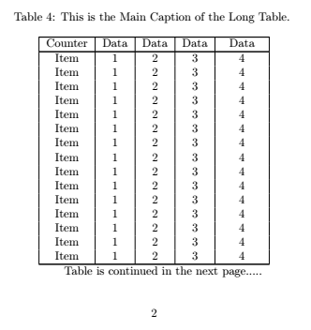
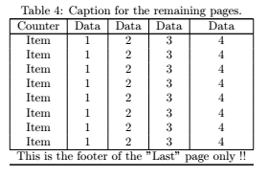
Long Tables

Slide 3


Long Tables’ Structure: Headers
Main Heading for First Page:
Caption Command.
Header Entries.
Ends with \endfirsthead
Heading for remaining pages:
multicolumn Command as caption.
Header Entries again.
Ends with \endhead

Slide 4
Long Tables’ Structure: Footers
Footer for First Pages:
multicolumn Command as text.
Ends with \endfoot
Footer for The Last Page:
multicolumn Command as text.
Ends with \endlastfoot

Slide 5
Thanks for Watching !!

